Slide 1
Load Testing

Slide 2
Introduction
In software testing, load testing is an integral part of performance testing under non-functional testing.
Load testing is testing where we check an application's performance by applying some load, which is either less than or equal to the desired load.
Here, load means that when N-number of users using the application simultaneously or sending the request to the server at a time.
Load testing will help to detect the maximum operating capacity of an application and any blockages or bottlenecks.

Slide 3
Rules for load testing
During the execution of the load testing, a test engineer should follow the below rules:
A test engineer tries to evade downloading images on the site.
Once the application becomes functionally stable, load testing should be planned.
The reliability of response time concludes the past period should be logged and the same should be compared with several test runs.
For each scenario or script number of users should be decided.

Slide 4
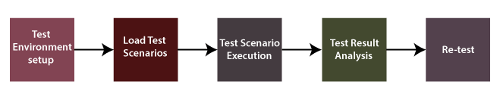
Load Testing Process

Slide 5
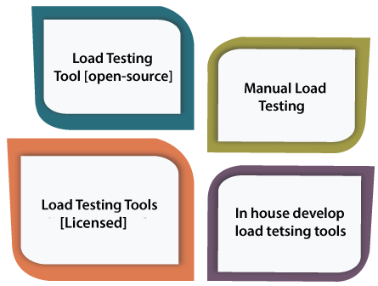
Types of Load Testing tools

Slide 6
Advantages
Some of the vital benefits of performing the load testing are as follows:
Load testing helps us to detect the bottlenecks and performance-related issues before production.
The load testing enhances the scalability regarding network, software and database for the system or software application.
The major advantage of performing the load testing is reducing the cost failures, which also helps us minimize the system interruption risks.
Customer's satisfaction is enhanced while using the load testing.

Slide 7
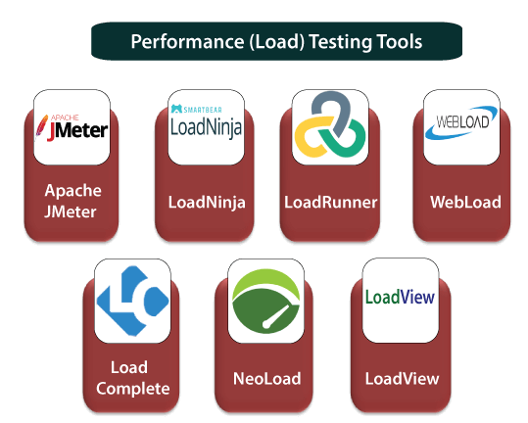

Slide 8
Thank you

